Slide 2
explore the concepts of HIVE.
learn features of HIVE.
understand architecture of HIVE.
learn components and functionalities of HIVE.
explore working of HIVE.

Slide 3

Introduction

Slide 4
Introduction
Most Popular

Slide 5
Introduction

Slide 6
Introduction
Developed By

Slide 7

Introduction
Developed By

Slide 8

Introduction
Developed By

Slide 9


Introduction

Slide 10


Introduction
Process Structured Data in Hadoop

Slide 11
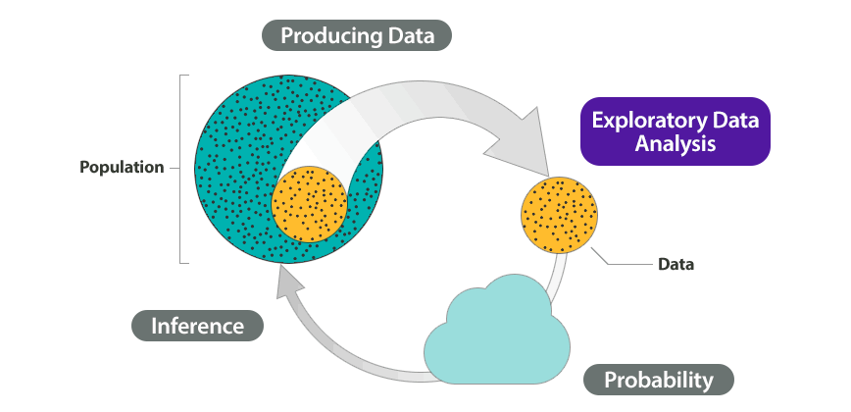
Introduction
Summarize Big Data

Slide 12

Introduction

Slide 13

Introduction
Amazon elastic MapReduce

Slide 14


Introduction
Hive is not

Slide 15

Introduction
Hive is not
Designed for OLTP(Online Transaction Processing)

Slide 16
Introduction
Hive is not
A language for real-time queries
and row-level updates

Slide 17

Hive
Features of HIVE
1. Store Schemas
Database

Slide 18

Hive
Features of HIVE
1. Store Schemas
Database

Slide 19

Hive
Features of HIVE
Store Schemas
Designed for
OLAP

Slide 20
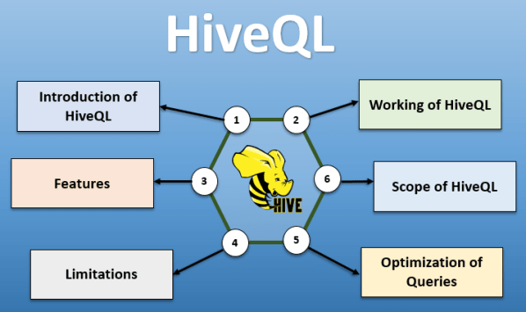
Hive
Features of HIVE
Store Schemas
Designed for
provides SQL type
language for querying called

Slide 21
Hive
Features of HIVE
Store Schemas
Designed for
provides SQL type
language for querying called
4. Familiar, fast, scalable, and extensible.

Slide 22
Architecture of HIVE

Slide 23
Architecture of HIVE
Next Figure shows the overall architecture of Hive. If you can under this architecture diagram you can easily remember how Hive works.

Slide 24
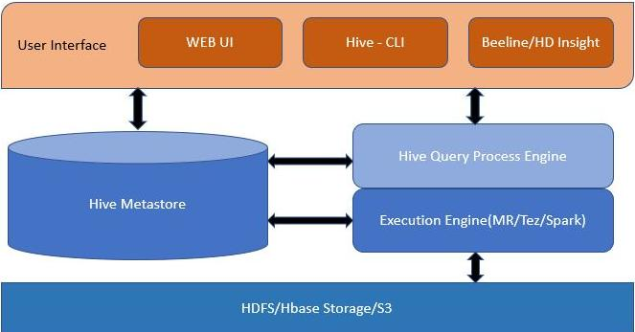
Architecture of Hive

Slide 25
Architecture of Hive

Slide 26

Architecture of Hive
Interact
End User

Slide 27
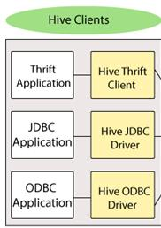
Architecture of Hive

Slide 28
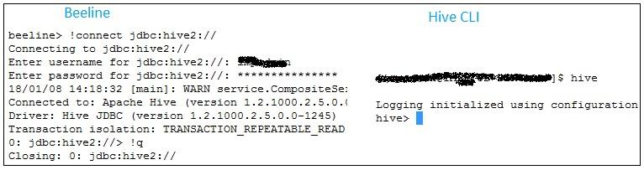
Architecture of Hive

Slide 29
Architecture of Hive
Hive Query Process Engine

Slide 30

Architecture of Hive

Slide 31
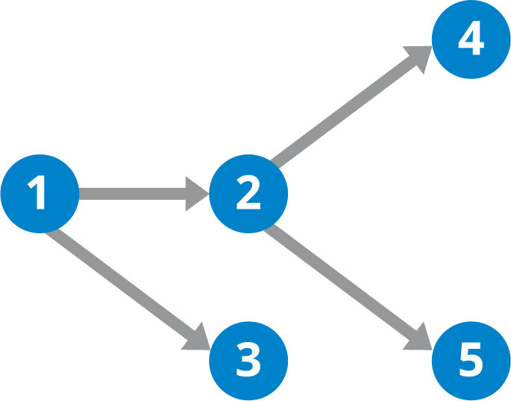
Architecture of Hive
Directed Acyclic Graph

Slide 32
Architecture of Hive
Execution Engine(MR/Tez/Spark)

Slide 33
Architecture of Hive
It is where the actual processing of the data will start.
After compiler checking the syntax, performs the optimizations of the execution.
Finally this execution plan will be given to Execution Engine. We have several execution engines that can be used with Hive.
MapReduce is one of the execution engines.

Slide 34


Architecture of Hive

Slide 35
Architecture of Hive
set hive.execution.engine=spark;
set hive.execution.engine=tez;
set hive.execution.engine=mr;

Slide 36
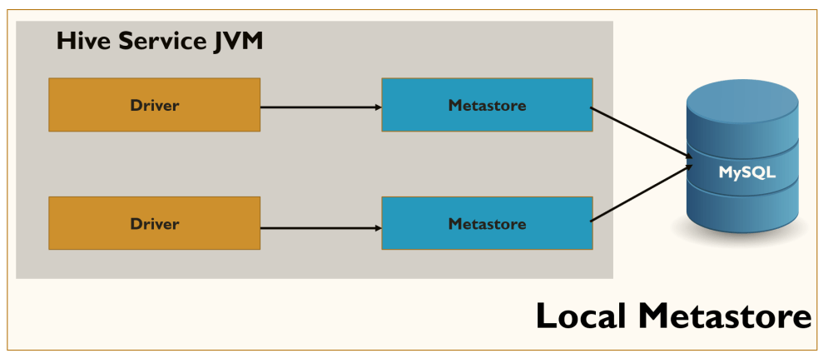
Architecture of Hive
Metastore

Slide 37
Architecture of Hive
Metastore can be used in two modes.
Remote mode
Embedded Mode

Slide 38
Architecture of Hive
HDFS or Hbase
Storage

Slide 39

Architecture of Hive
HDFS or Hbase
Storage

Slide 40

Architecture of Hive
HDFS or Hbase
Storage

Slide 41

Architecture of Hive
HDFS or Hbase
Storage

Slide 42
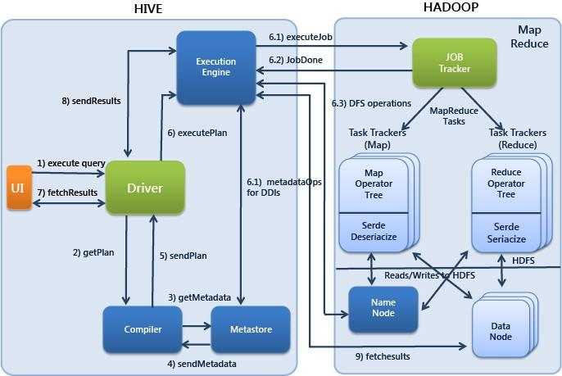
Components of HIVE

Slide 43

Working of HIVE

Slide 44
Working of HIVE
User interface
Step 1

Slide 45
Working of HIVE
User interface
Step 1
Driver

Slide 46
Working of HIVE
User interface
Step 1
Driver
Step 2
Complier

Slide 47
Working of HIVE
User interface
Step 1
Driver
Step 2
Complier
Step 3 & 4:
MetaStore

Slide 48
Working of HIVE
User interface
Step 1
Driver
Step 2
Step 5
Complier
Step 3 & 4:
MetaStore

Slide 49
Working of HIVE
Execution Engine
Step 6
User interface
Step 1
Driver
Step 2
Step 5
Complier
Step 3 & 4:
MetaStore

Slide 50
Working of HIVE
Execution Engine
Step 7 and 8
Hadoop
Job Tracker
Step 6
User interface
Step 1
Driver
Task Tracker
Step 2
Map
Reduce
Step 5
Complier
Step 3 & 4:
MetaStore
Name Node
Data Node

Slide 51
What is Hive in Hadoop?
Submit SQL queries and perform MapReduce jobs.
Hive has its own language, called HiveQL (HQL).
It is similar to SQL.
It translates SQL-like queries into MapReduce jobs.
Don’t need to learn Java to work with Hadoop Hive.

